Slide 1
MICROINSURANCE DEVELOPMENT IN AFRICA
BY: ERIC AGYEMANG
Illinois State University
Department of Mathematics
USA.
Email: e.agyemang@rocketmail.com

Slide 2
Outline
Problem Background.
Purpose of the Study.
Methodology.
Results and Implications.
Conclusion
Future Research.

Slide 3
PROBLEM BACKGROUND.
Microinsurance is an essential tool for protecting the health and livelihoods of under-served low-income populations in emerging markets and developing countries.(By National Association of Insurance Commissioners (NAIC)).
Insurance coverage remain exceedingly low in developing countries-often below 5% of the country’s population(By Consultative Group to Assist the Poor(CGAP)).
Using insurance and risk-management approaches ... effectively in Africa is critical to achieving several of the Sustainable Development Goals (By Katharine Pulvermacher).

Slide 4
Purpose of the Study
To identify key factors that are prerequisites for success in creating fertile environment for the development of inclusive insurance markets in Africa.
To identify the key factors contribution to microinsurance market development in Africa.
Highlight the implications for policymakers and the private sector wishing to scale up inclusive insurance market development in Africa.

Slide 5
Methodology
Data Collection.
Data on 22 Africa countries for the years 2014 – 2018 collected from World map of Microinsurance, and range of public sources based on extent literature review and data availability for countries.
Data consist of 110 observations.
Countries used
Benin Ivory Coast Nigeria Tunisia
Burkina Faso Kenya Rwanda Uganda
Botswana Malawi Senegal Zambia
Egypt Morocco South Africa Zimbabwe
Ethiopia Mozambique Namibia
Ghana Niger Togo

Slide 6
METHODOLOGY Cont.
Model Construction
Python-Jupyter Notebook used for analysis.
Person product moment coefficient of correlation
Multilinear regression model constructed; the OLS used to estimate the specifications of the model.
Checking model assumption: Normality, Autocorrelation, Heteroscedasticity and mean of residuals approximately equal to zero.

Slide 7
METHODOLOGY Cont.
Proxies used:
Microinsurance Density (Total Premium/ Total Population): Used as a gauge of microinsurance development (Lee et al. , 2013; Simona et. al, 2014).
Ease of doing Business: Used as a gauge of how conducive
the regulatory environment is, to starting and operating a
local firm (Malpass, 2020).

Slide 8
METHODOLOGY Cont.
Factors of Microinsurance suggested by literature Review.
Demographic: Age Dependency Ratio, Population Total, Population Growth Rate, %Population Poor, % Population Living in Rural Areas, % individual using internet, and Mobile-cellular telephone subscriptions.
Economic: GNI per Capita, Net Income Per Capita, Inflation, Real Interest Rate, Merchandised Trade, Insurance Penetration, and Insurance Density.
Institutional: Business Freedom, Openness of Economy, Fiscal Freedom, Financial Freedom, Property Right, Investment Freedom, Fragile State Index, Government size, Rule of Law, and Labor Freedom.

Slide 9
Results and Implications
Person product moment coefficient of correlation
Insurance Penetration and Insurance Density with r = 0.97
Fiscal Freedom and Financial Freedom with r = 0.99
Openness of Economy and Property Right with r = 0.61
All other variables are not highly associated.

Slide 10
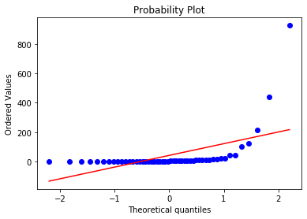
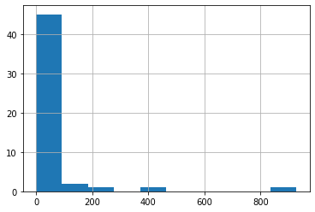
Results cont. Distribution of proxies
Microinsurance Density

Slide 11
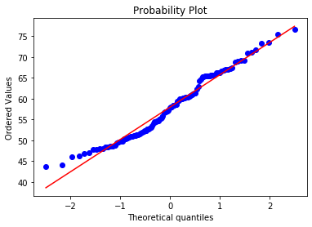
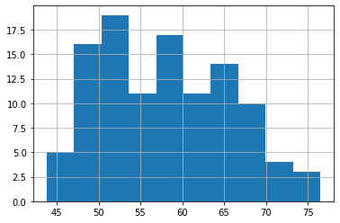
Results cont. Ease of doing Business

Slide 12
Results cont. Model Results
Microinsurance Density- R² = 0.660, Observations = 50
Category
Factor | Coefficient and p-value
Demographic Population Growth Rate | -2.1621** (0.011)
Demographic Mobile-Cellular telephone subscriptions | -0.0180 (0.10) *
Demographic % Population Living in Rural Areas | -0.0713* (0.10)
Economic Inflation | -0.1723*** (0.002)
Economic Real Interest Rate | -0.1154* (0.067)
Economic Merchandised Trade | 0.0425** (0.049)
Institutional Business Freedom | 0.395** (0.0386)

Slide 13
Ease of doing Business - R² = 0.618, Observations = 110
Results cont.
Category | Factor | Coefficient and p-value
Demographic | % individual using internet | 0.0006* (0.095)
Economic | GNI per Capita | 0.01012*** (0.002)
Economic | Real Interest Rate | 0.0021*** (0.000)
Institutional | Business Freedom | 0.0008** (0.032)
Institutional | Openness of Economy | 0.0017*** (0.041)
Institutional | Property Right | 0.0007*** (0.023)
* **p≤0.01, **p≤0.05, *p≤0.10

Slide 14
Results cont. Implications
1% increase in merchandised trade, and business freedom will leads to microinsurance development.
1% decrease in population growth rate, mobile-cellular telephone subscriptions, percentage of population living in rural area, inflation, and real interest rate will impede upon microinsurance development.

Slide 15
Results cont.
1% increase in %individual using internet, GNI per capita, real interest rate, business freedom, openness of economy, and property right results to an increase in ease of doing business which provides fertile grounds and avenue for microinsurance establishment and operation.
Note: All other variables included in the analysis but not presented are not significant contribution to the proxies.

Slide 16
Conclusion
At a practitioner level, the study’s findings are very useful to policymakers and the private sector wishing to scale up inclusive insurance market development in Africa.
For the individuals and firms planning to enter into microinsurance market in Africa, It serve as a guide to identify the key factors influencing microinsurance market development and creating fertile environment for microinsurance operation.

Slide 17
Future Research
consider mining data covering many years on the variables used for this study.
Hofstede cultural dimensions, life expectancy at birth, urbanization, microinsurance growth rate, corruption perception index and microinsurance penetration for the countries could also be included.
Incorporating these variables in the model may lead to a more interesting results.

Slide 18
THANK YOU (e.agyemang@rocketmail.com)

